Slide 1

MIS - 636 - Data Warehousing And Business Intelligence
Professor: Joseph Morabito
Presented By Group 3:
Shikuan Gao
Xiang Yang
Jiarui Li
Zhongyong Zhang
Rajakumar Jagannathan Surresh

Slide 2

Contents
Introduction
Why DW & BI system?
Services Offered
Business Process
Prioritization Grid
Bus Matrix
Logical Schema
OLAP Cube
Financial Analyst Dashboard
Shipping Analysis
Conclusion

Slide 3
Introduction
Costco Wholesale Corporation, trading as Costco, is the largest American membership-only warehouse club
First it was found on July 12, 1976 as Price Club in San Diego, California.
Established Costco on September 15, 1983 in Seattle, Washington by merging with Price Club who was their competitor
In the United States, Costco's main competitors operating membership warehouses are Sam's Club and BJ's Wholesale Club
Costco employs more than 205,000 people worldwide full and part-time employees
Costco was the first company to grow from zero to $3 billion in sales in under six years
The ACSI (The American Customer Satisfaction Index) named Costco number one in the specialty retail store industry with a score of 84 in 2014
As of 2015, Costco was the second largest retailer in the world after Wal-Mart

Slide 4
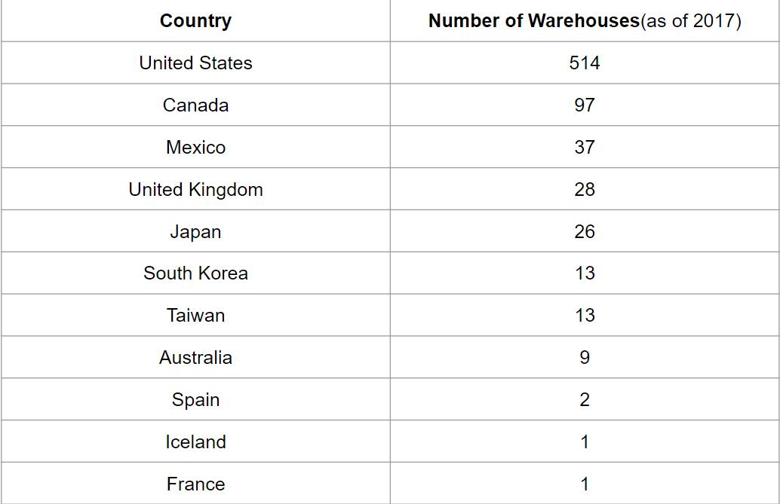

Slide 5
Why DW & BI System?
Costco competes with bigger wholesale traders like Walmart, BJ’s and Sam’s Club by focusing on selling products at low prices, often at very high volume
These goods are usually bulk-packaged and marketed primarily to large families and businesses
A DW & BI system will help,
Analyze their business and maximizing profits
Managing inventory of products
Make better decision making at all levels
Cleverly decide on product substitutes
Manage promotions and sales
Dashboards/Visualizations to better monitor daily activities

Slide 6
Services Offered
Concierge Service:
Costco offers a free "concierge" service to members who purchase electronics, to help answer questions regarding setup and use and avoid potential returns due to not understanding how to use the products
Costco Business Services:
NOVA Information Systems (NOVA) partnered with Costco to market and support payment processing services to Costco Canada's Business Executive Members
Costco Travel:
Costco Travel is a wholly owned subsidiary of Costco Wholesale and offers leisure travel to Costco members of the United States and Canada
The program offers vacation packages to the Caribbean, Europe, Florida, Hawaii, Las Vegas, Mexico, and the South Pacific
Food Service:
All but a few Costco locations have a food court. Some are inside, some are outside, but the menu is essentially the same: hot dog with drink, pizza, frozen yogurt, various drinks, baked items, and sandwiches.

Slide 7
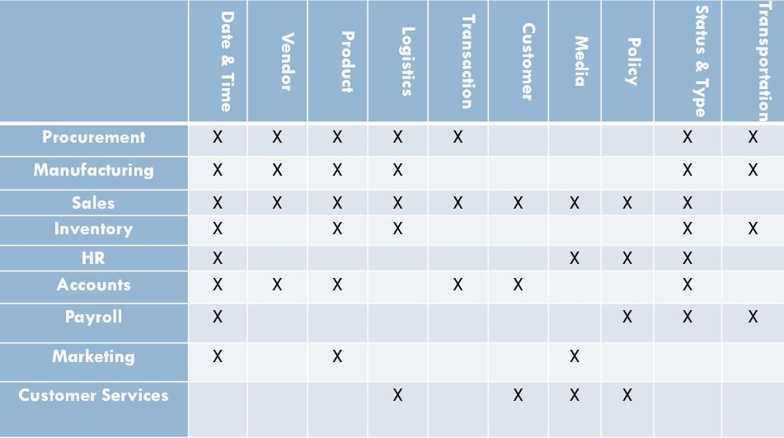
Business Process

Slide 8
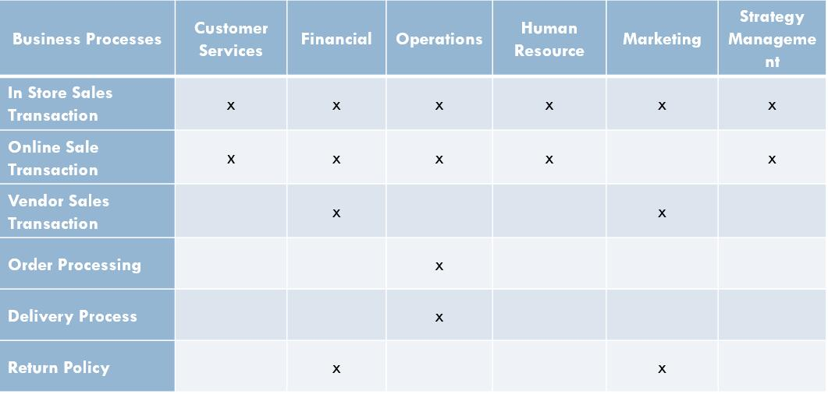
Opportunity Matrix

Slide 9
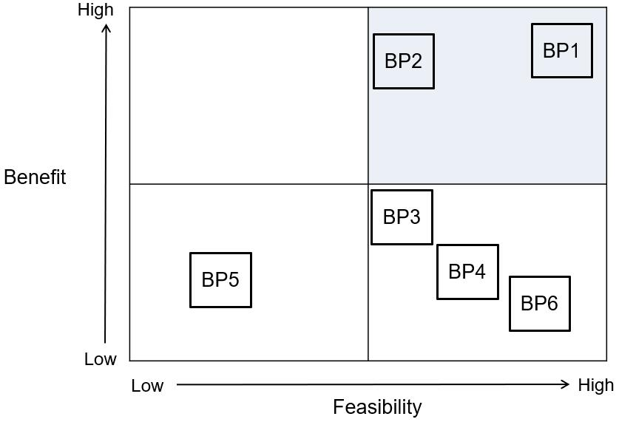
Prioritization Grid

Slide 10
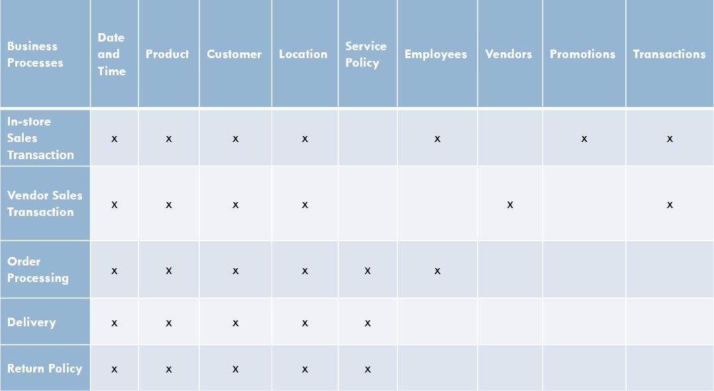
High Level Bus Matrix

Slide 11
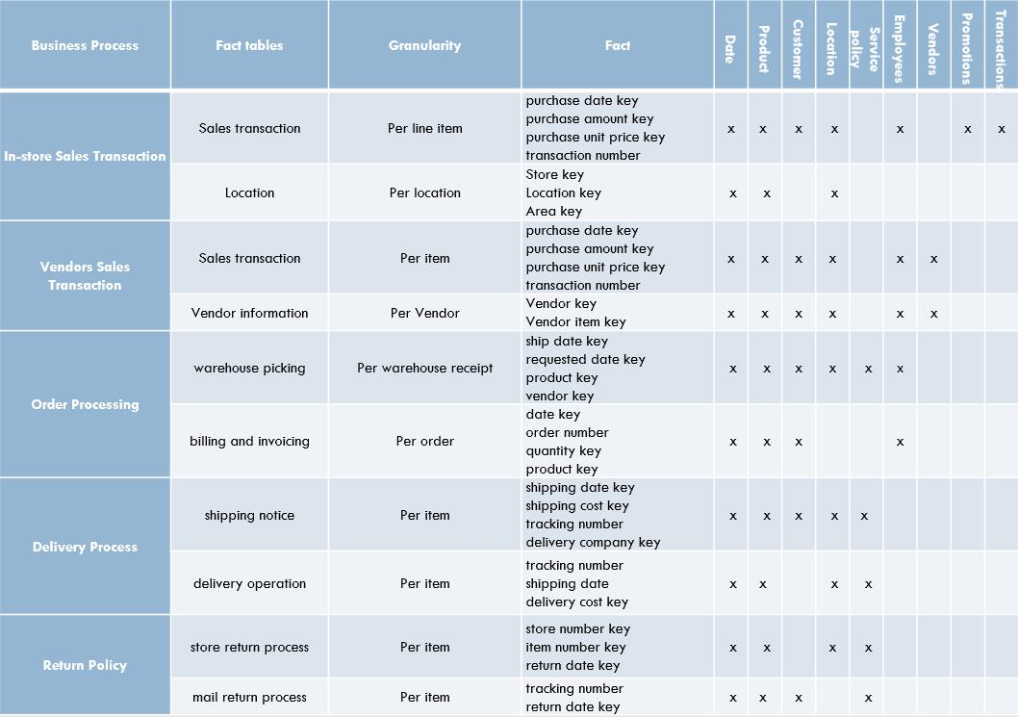
Detailed High Level Bus Matrix

Slide 12
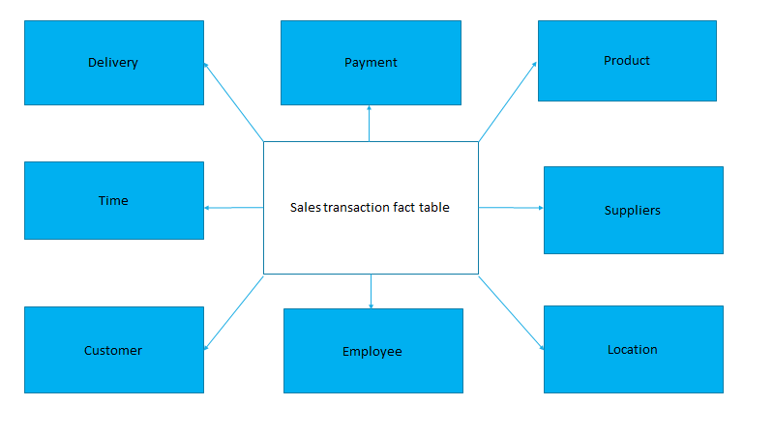
Logical Schema

Slide 13
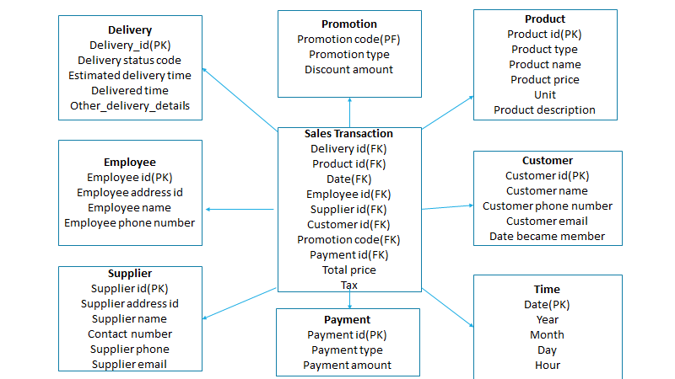
Star Schema

Slide 14
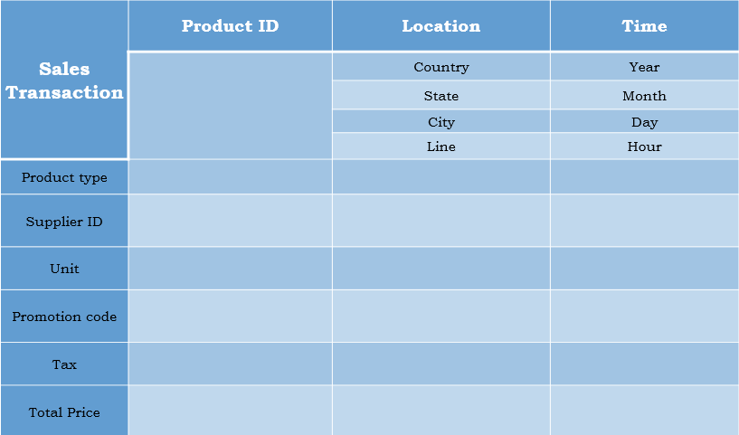
Product Table

Slide 15
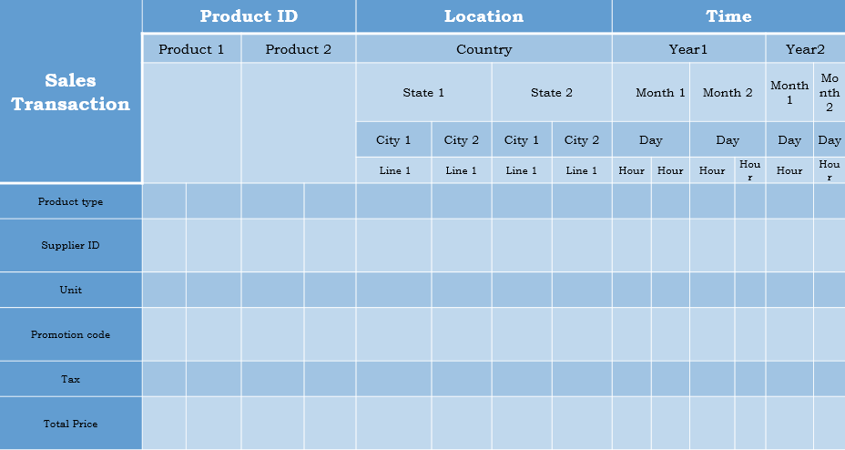
Aggregate Table

Slide 16
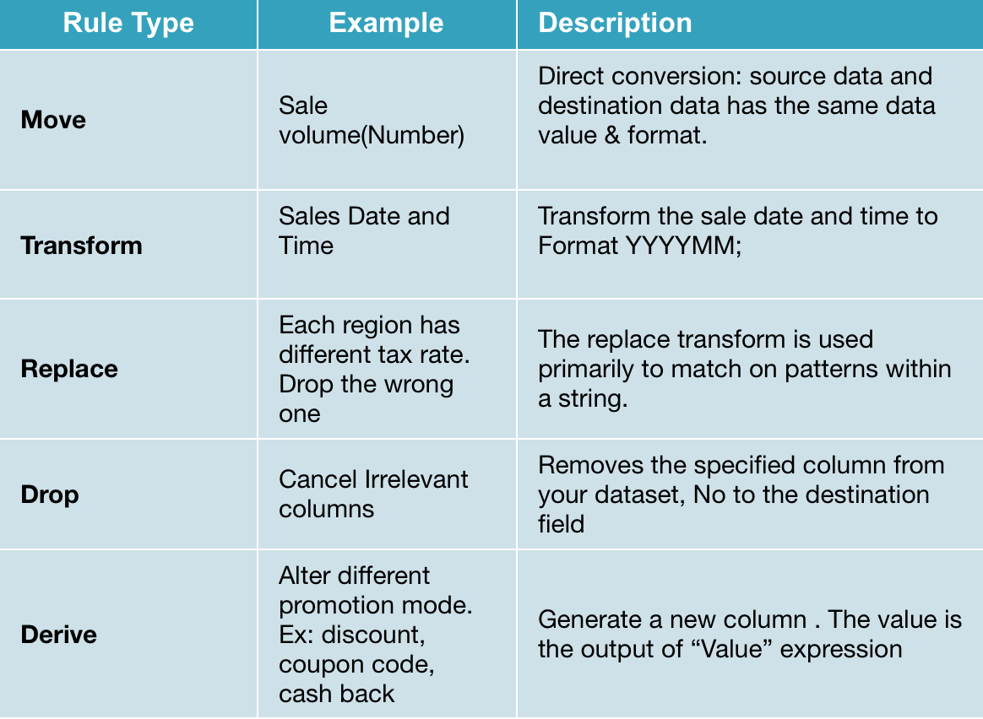
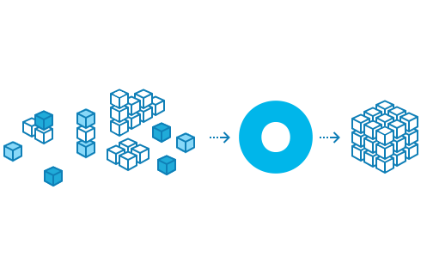
Representative Transformation Rules

Slide 17
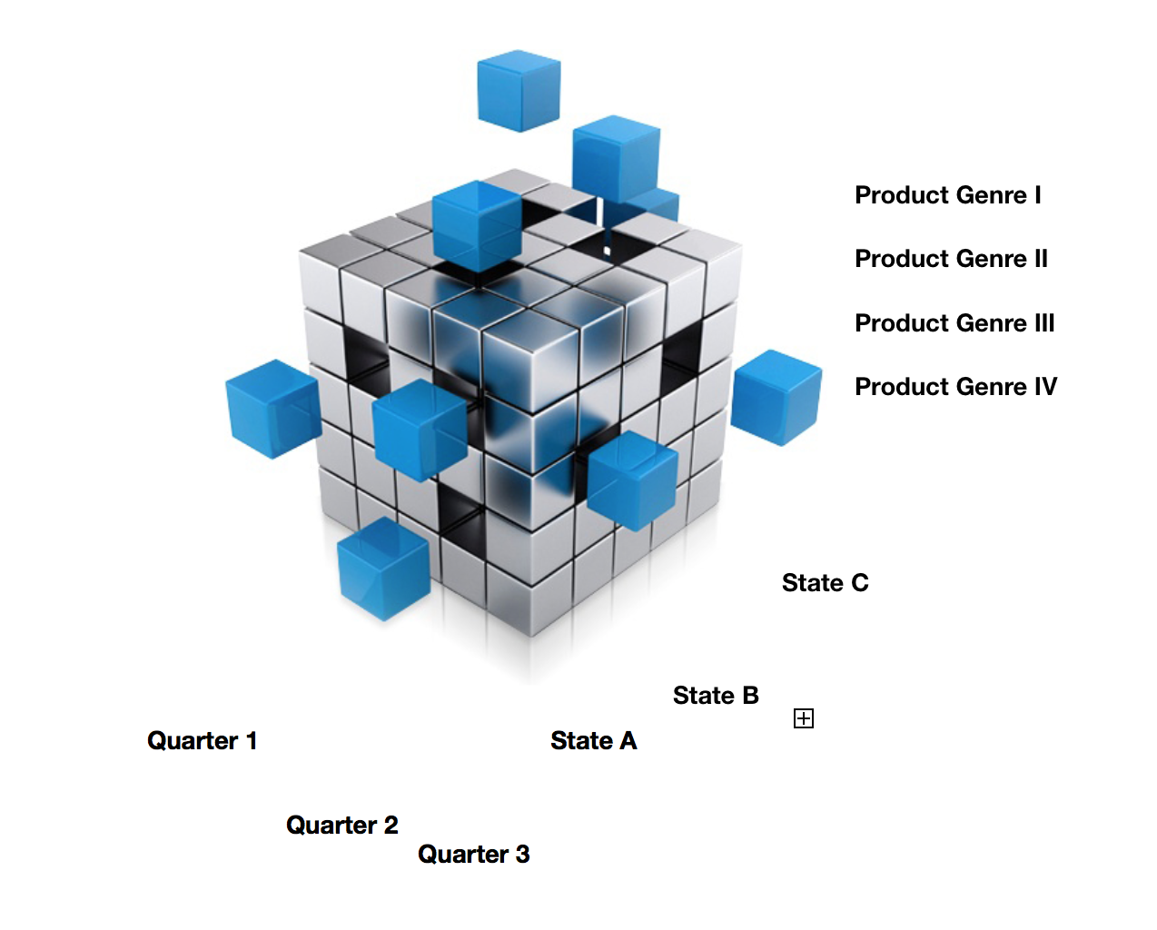
OLAP Cube
The dimensions respectively are State Zone, Time Zone and Service Genre. All of them are Dense

Slide 18
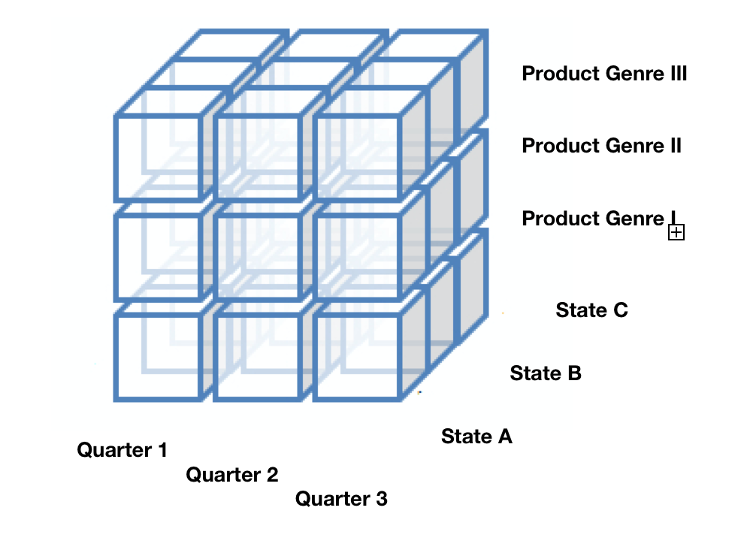
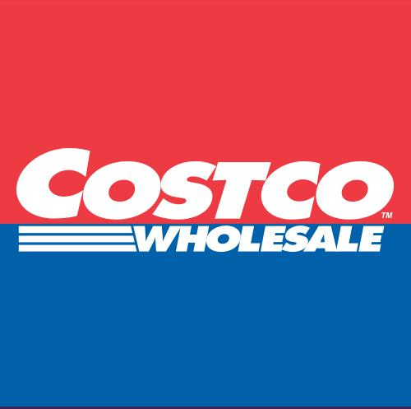
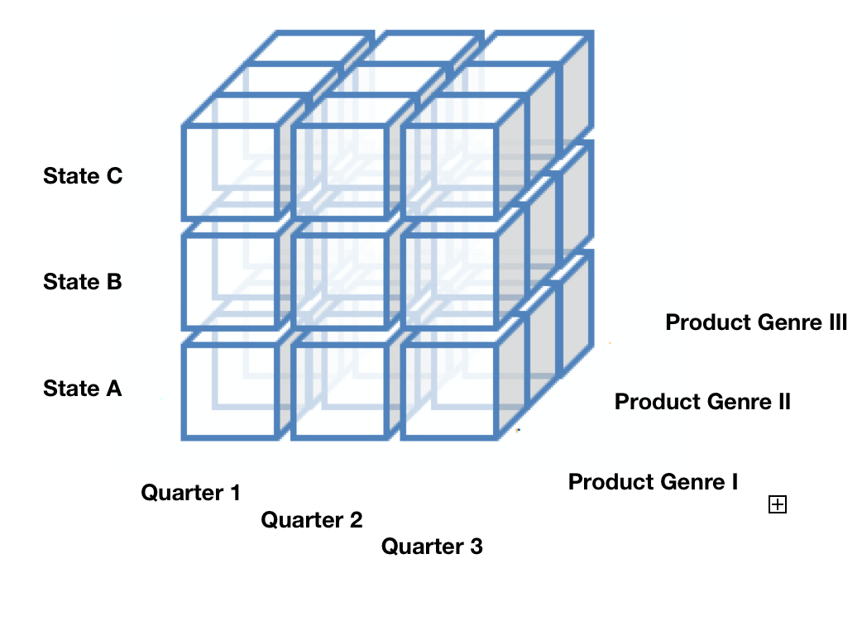
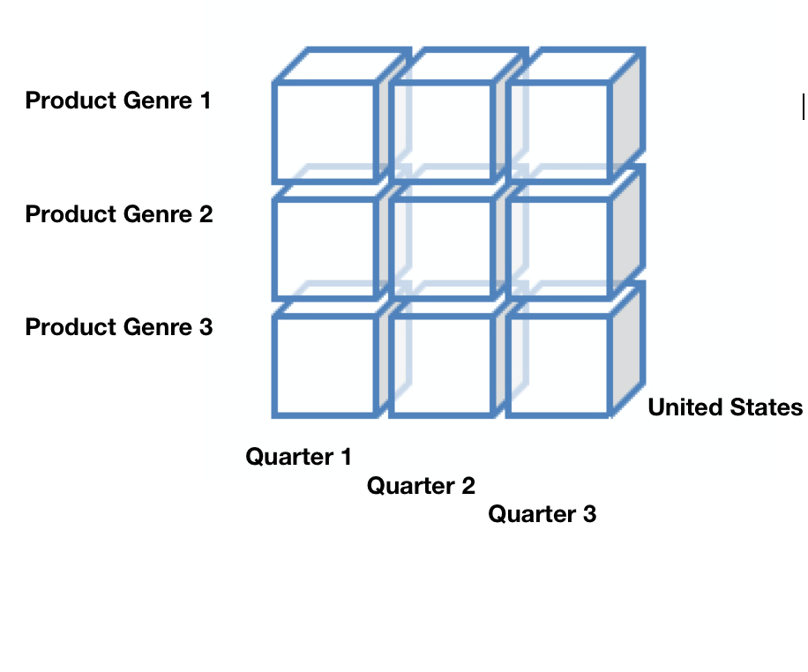
OLAP Cube
Drill Down, Pivot and Roll Up

Slide 19
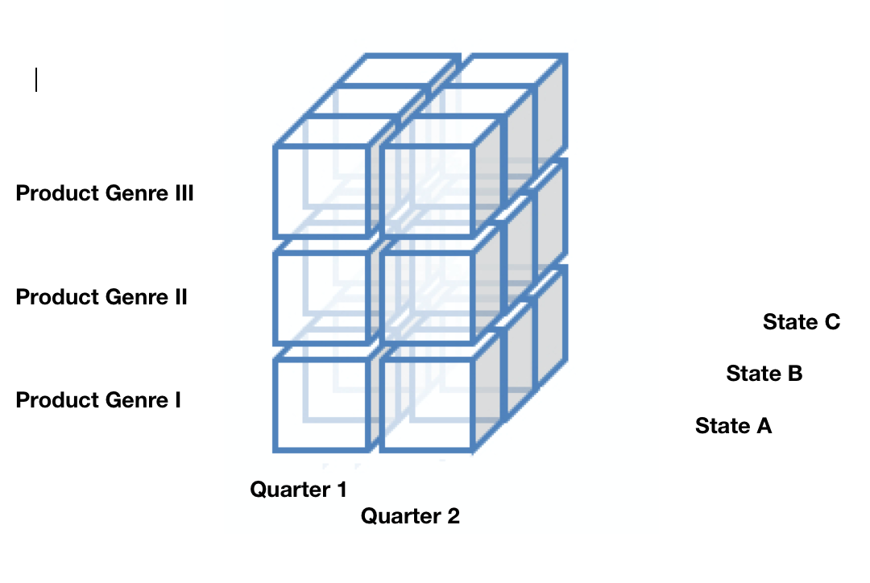
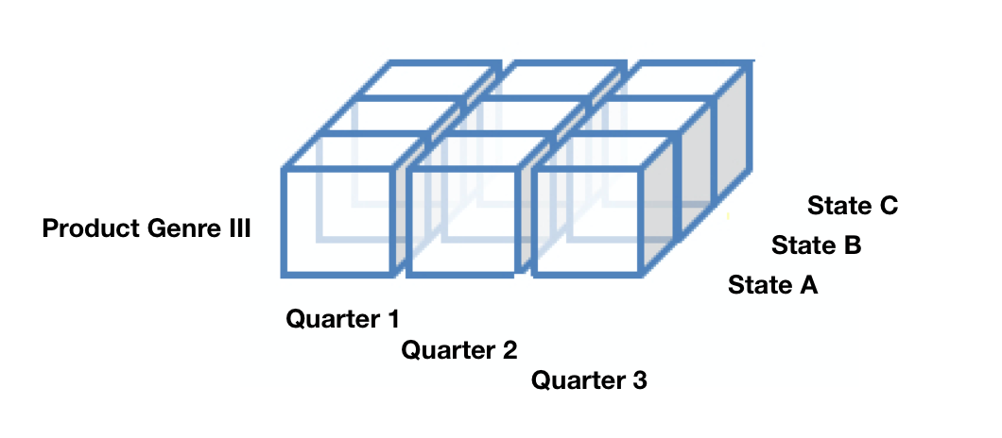
OLAP Cube
Dicing and Slicing

Slide 20
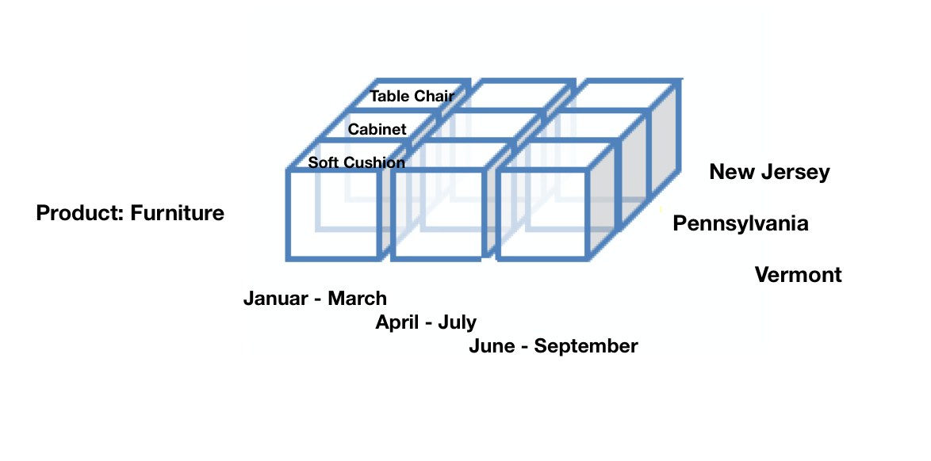
OLAP Cube
Slicing Operation Sample

Slide 21
User Profile:
Job Role Tasks
 | User Role | Specific Tasks | Delivery(Types of Output)
Executives | Director of Functional Division | Concentrate on Weekly/Monthly/Quarterly reports; As a role of decision-maker Supervise capability | Portal, Reports
 | Director of Geographic Division | Provide recommendations to headquarter | Portal, Reports
Analysts | Financial Analyst | Research on macroeconomic and microeconomic conditions of Costco’s fundamentals Prepare financial model and draft reports circling around financial factors(sales volume, revenue, profits) | BI Portal, OLAP cube, Customized Dashboard
 | Business Analyst | Informative explanatory Custom dashboards to monitor product details | BI Portal, OLAP cube,, Customized Dashboard

Slide 22
User Profile:
Job Role Tasks
 | User Role | Specific Tasks | Delivery (Access Methods)
Analysts | Marketing Analyst | Analyze marketing trends, Understand customer preference Understand customer consuming patterns | BI Portal, OLAP cube, MOLAP, Customized Dashboard
 | Risk Analyst | Monitor operational activities and region-wise activities Predict potential risks | BI Portal, OLAP cube, Customized Dashboard
Operational Workers | Branch Store Managers | Access to data details create simple reports Drill down capabilities | Operational reports

Slide 23
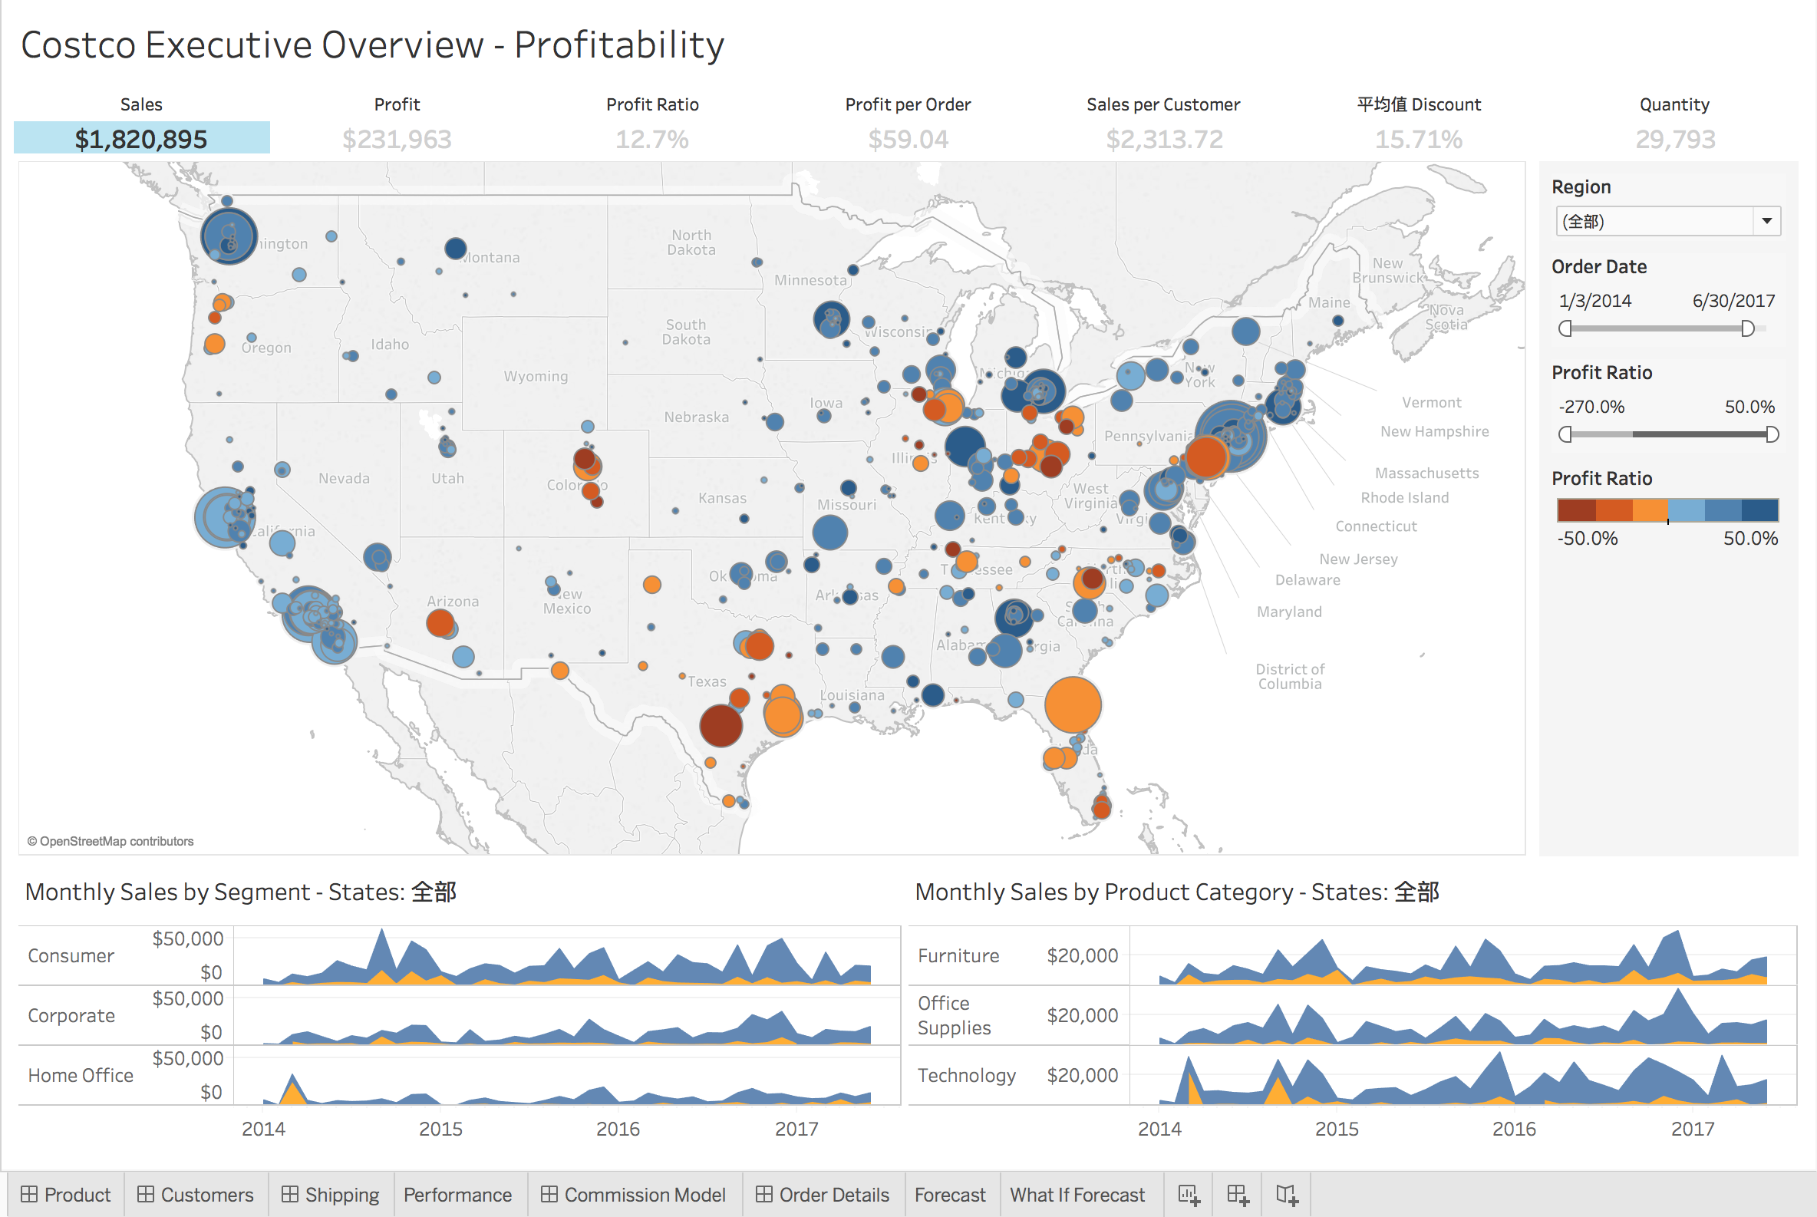
Financial Analyst Dashboard

Slide 24
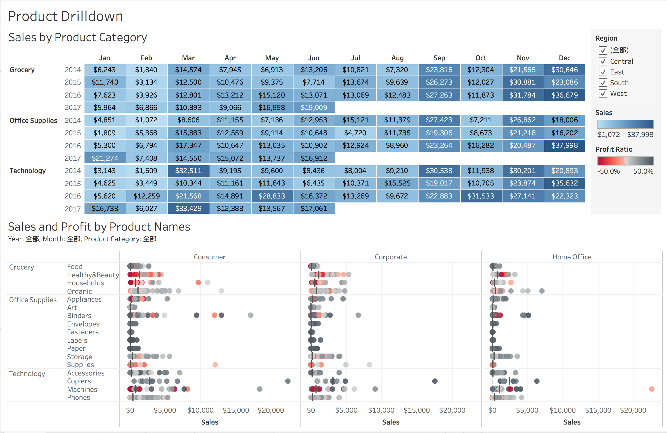
Product Details

Slide 25
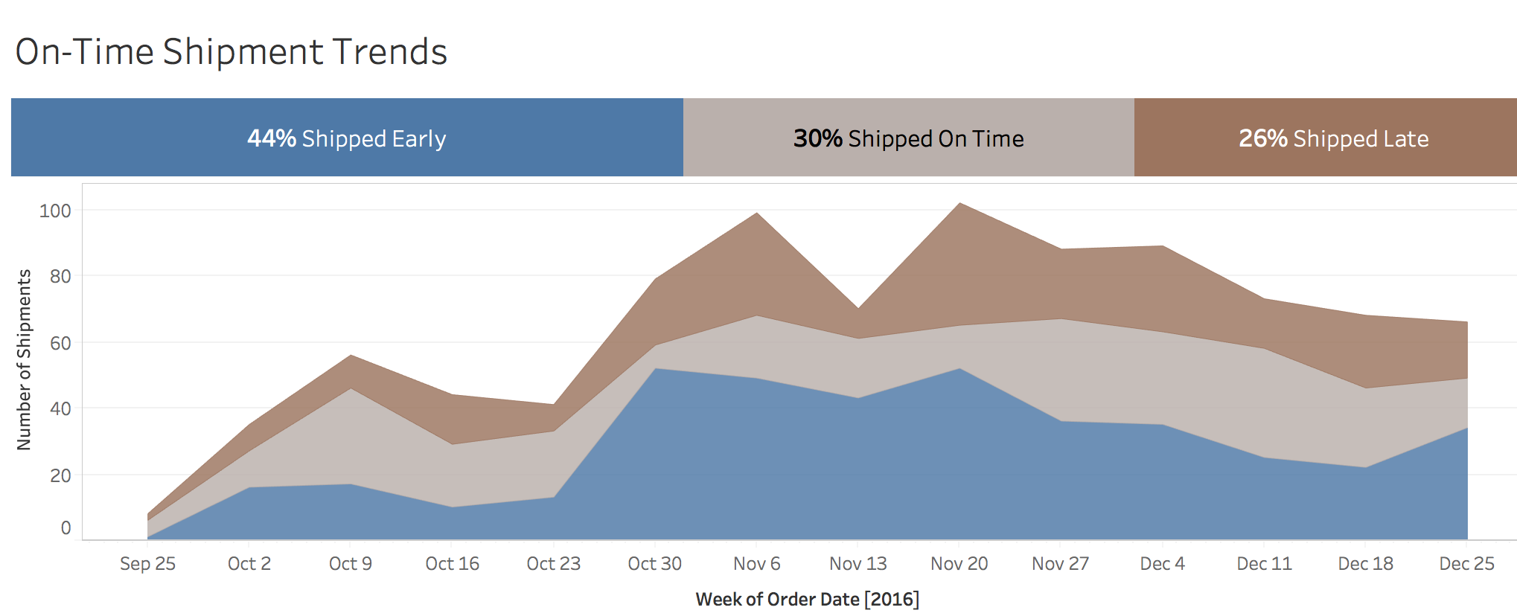
Shipping Analysis

Slide 26
Conclusion
This BI & DW system will assist Costco better understanding to analyze their daily business process
The statistics are valuable for the top management in the organization to make better decisions
The financial analyst dashboard integrated with OLAP queries will give a different dimension in viewing data thus aiding decision making

Slide 27
Thank You

